Slide 1
Bryan Huang Weiqi Li Yashuo Wang (Gloria) Van Xu Jose Zuart
Data science for business: final project
Default prediction on loans in India

Slide 2
Overview
Business Understanding
Data Understanding & Data Preparation
Modeling & Evaluation
Deployment & Risks

Slide 3
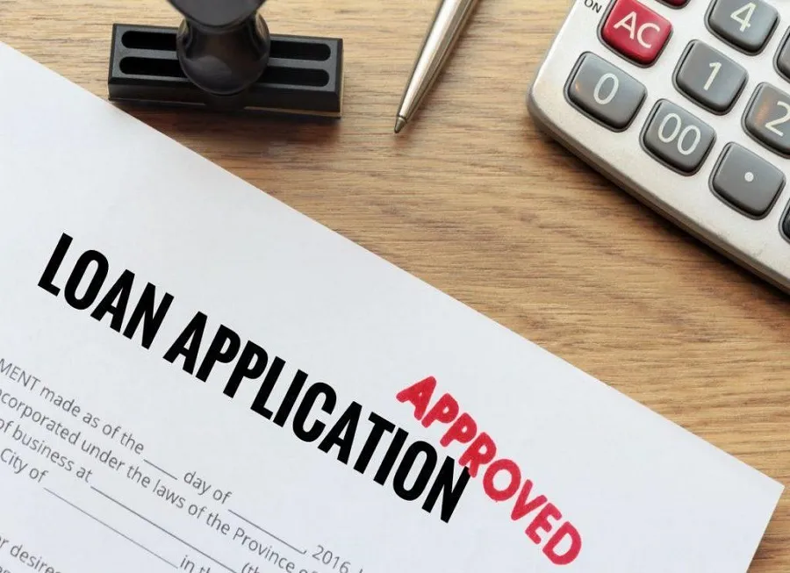
Business Understanding
7.39% of the total gross loans in India are non-performing. .
Business problem: define if the client is going to default the credit or not.
Goal: increase profitability of banks
Notes:
Recovery agents cost the bank time and money. It’s a very inefficient process.

Slide 4
Data Understanding and Data Preparation
Data source: 252,000 samples in indian commercial banks from Kaggle.com.
13 variables in the data set (ID, Income, Age, Experience, Married/Single, House Ownership, Car ownership, profession, City, State, Years on the current job, Years on the current house and Risk flag).
No missing values in the columns and no unexpected variables in the data.
Training set (202,000 samples) and holdout testing set (50,000 samples).
Notes:
51 professions, 317 cities, 29 states, risk flag is the target variable for prediction.

Slide 5
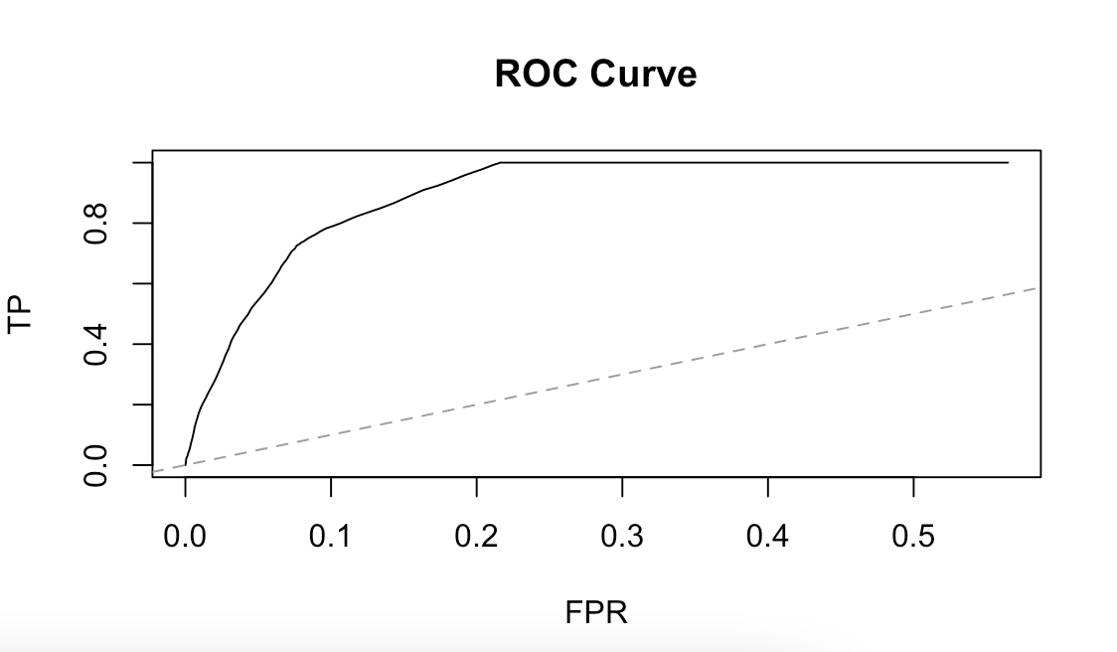
Modeling
Random forest model on all variables
Nodesize = 5
Ntree = 500
Mtry = 4
Threshold = 0.1
AUC = 0.9387
K- means clustering
PCA
Logistic regression
Classification tree
Lasso and Post-Lasso
HDIC result indicates an optimal k value of 17
BIC and AIC >50
May lead to severe overfitting
No unlabeled data
.
AUC of .665
AUC of .5
Lasso AUC of .6363
Post-Lasso AUC of .6367

Slide 6
Evaluation
What do we want?
TPR FPR
For our business problem:
Goal is to predict defaulting we want higher TPR, with a relatively low FPR
Final Model (Random Forest): TPR: 0.996, FPR: 0.214
Accurate enough to capture risk!
To project expected benefit need more data on loan default rate and cost; A/B testing

Slide 7
Deployment
First defense for personal loan application in commercial banks
Identify those that are “flagged”
If flags are justified - reject or not? what interest rates / fees?
If flags are not justified - back into the general loan application screening process.
Potential Issues & Risks:
Biases towards customers
Over-dependence on the predictive model - collect more information about each client & add human intervention

